Slide 1

Bank Loan and Debit & Credit
MEET OUR TEAM (Group-05)
DEEPTI PATIL
ABHISHA
DARSHAN
NISHAR ALI
MONIKA ACHARJEE
VALLAI

Slide 2

INTRODUCTION
Our project is divided into two main modules – Bank Loan Management and Credit & Debit Card System
This project focuses on developing a comprehensive banking system that manages loan processing and credit & debit card operations efficiently.
The Bank Loan module handles loan applications, eligibility verification, approval processes, interest calculation, and repayment tracking.
The Credit & Debit module manages card issuance, transaction monitoring, balance updates, and secure payment processing.
The objective of this project is to ensure accuracy, security, and transparency in financial operations using data-driven tools and analytical techniques.
The tools that are used in this projects are Excel, SQL, Tableau and Powerbi.
Using SQL for data management and Power BI/Tableau for visualization, we generated insights to support better financial decision-making.
Transforming banking data into meaningful insights for smarter financial decisions.

Slide 3





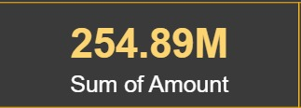
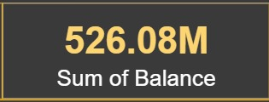
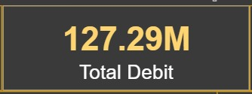
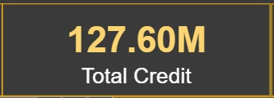
MAJOR KPI’s (bank loan data)
ABOUT KPI’s
TOTAL LOAN AMOUNT TOTAL FUNDED AMOUNT
TOTAL PAYMENT TOTAL FEES TOTAL INTERSET
BANK LOAN KPI’s
We’ve put out a massive 750.97M in total loans.
Out of that, we actually handed over 732.70M to our customers.
The best news? We’ve already collected 814.90M back.
This means we aren’t just breaking even; we’re making a healthy profit.
On top of that, we’ve made 1.22M just from fees alone.
We’ve got the interest of amount 155M too.
DBEIT & CREDIT KPI’s
We’ve total amount 254.89M and total balance is around 526.08M.
Total debit and credit is 127.29M and 127.60M which is nearly similar to each other.
MAJOR KPI’s(credit and debit data)
TOTAL AMOUNT TOTAL BALANCE TOTAL DEBIT
TOTAL CREDIT

Slide 4
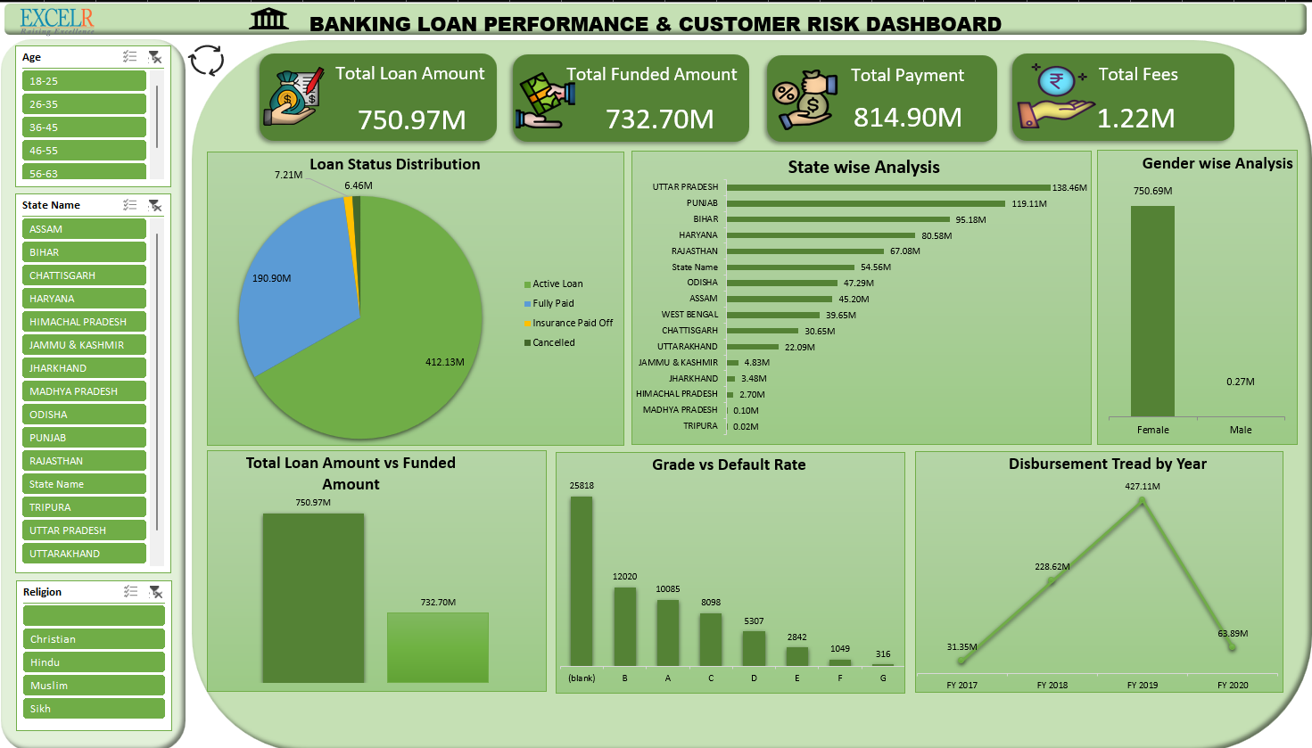
EXCEL DASHBOARD

Slide 5
INSIGHTS AND SUGGESTIONS.
🎯 Insight:
Loan business is concentrated in a few states. Some regions have very low penetration.
💡 Suggestion:
The bank should expand marketing in low-performing states. They can also analyze why top states are performing well and apply the same strategy in other regions.
🎯 Insight:
The bank might be focusing on women empowerment schemes or self-help groups. But the difference looks extremely high.
💡 Suggestion:
Check if the data is correct. If correct, the bank should try to balance the customer base to reduce risk concentration.
Need to create a loan product specially for men’s. It’s a huge market we’ve ignored.
🎯 Insight:
The increase shows business growth. The drop in 2020 may be due to economic slowdown (possibly COVID impact).
💡 Suggestion:
The bank should strengthen digital lending platforms. Also, create strategies to manage risks during economic crises.

Slide 6
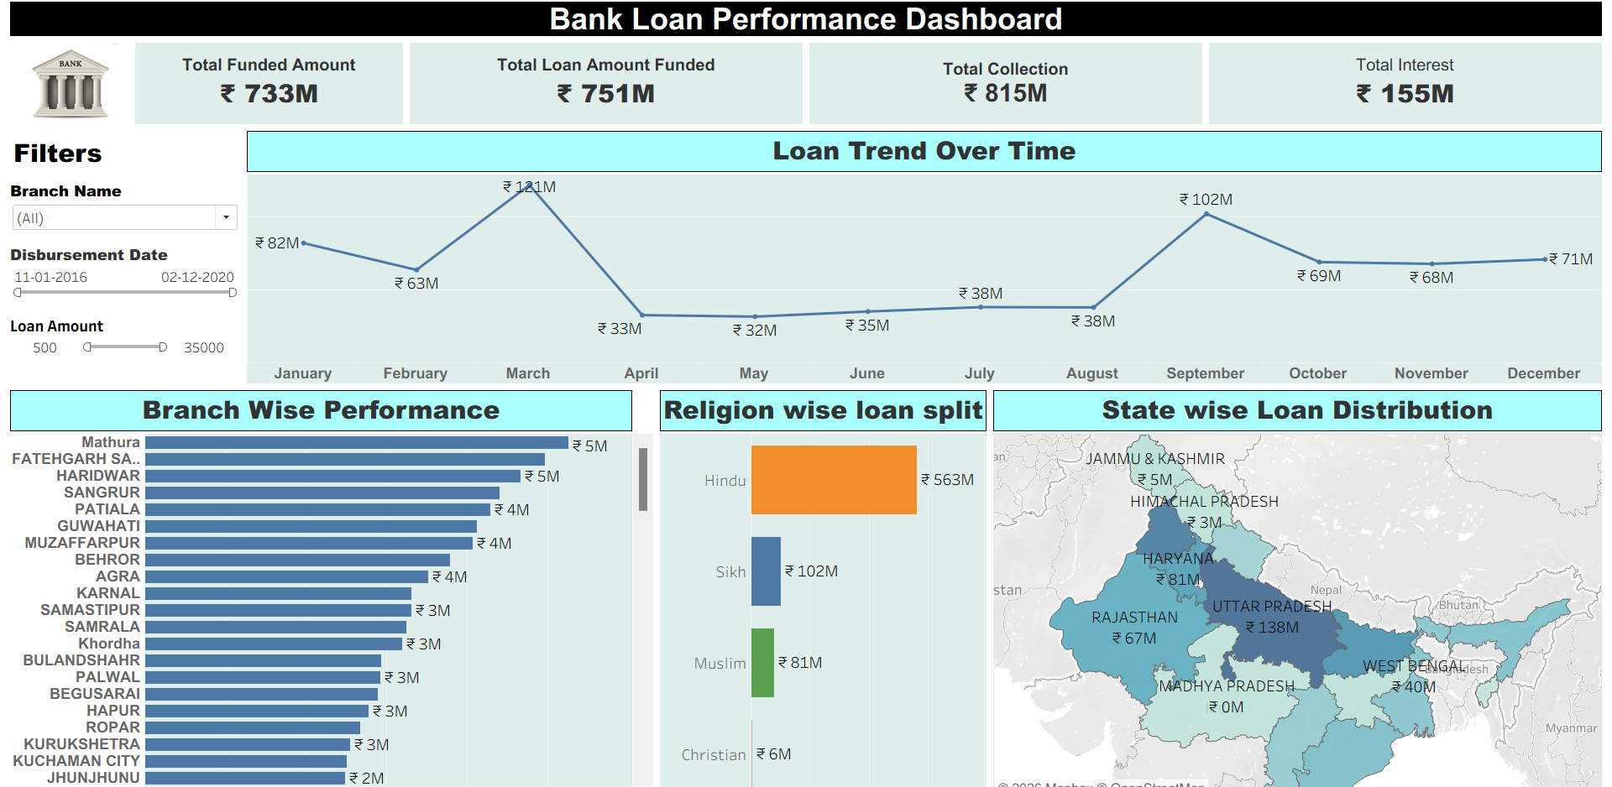
TABLEAU DASHBOARD

Slide 7
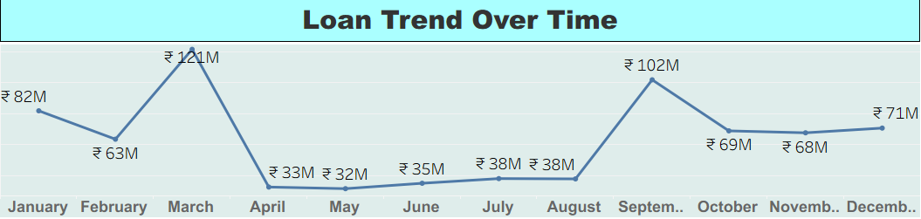
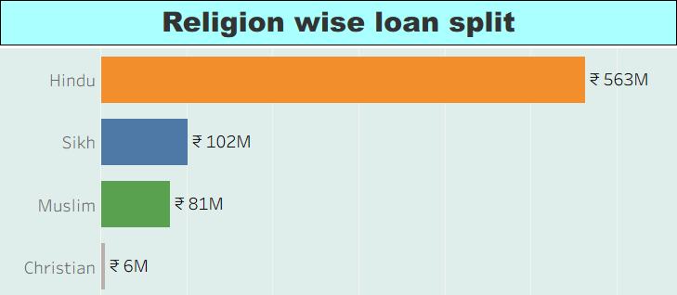
INSIGHTS AND SUGGESTIONS.
🎯Insights:
Loan disbursement peaked in March (₹121M) and September (₹102M).
Major drop observed in April (₹33M) and May.
After September, the trend stabilizes.
👉 There may be seasonal demand (financial year-end in March).
👉 April drop may be due to policy changes or reduced demand.
💡 Suggestions:
Investigate reasons for sharp drop in April.
Plan marketing campaigns before peak months.
Use predictive analysis to forecast high-demand months.
🎯 Insights:
Highest loans taken by Hindu customers (₹563M).
Sikh and Muslim segments also show significant contribution.
Christian segment is comparatively low.
👉 Loan distribution may reflect regional demographic patterns.
💡 Suggestions:
Ensure fair and inclusive lending policies.
Focus marketing campaigns in underrepresented communities.
Monitor for any unintentional bias.

Slide 8
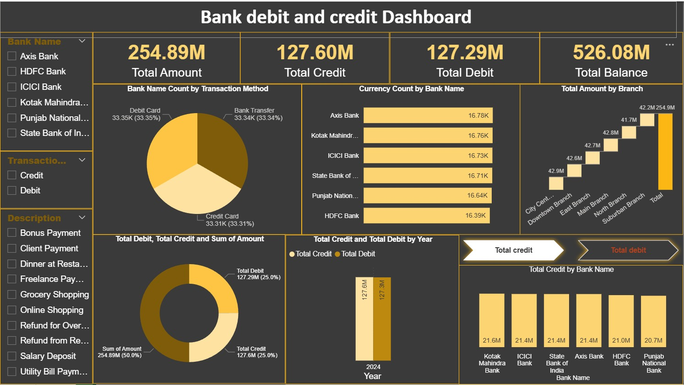
POWERBI DASHBOARD

Slide 9
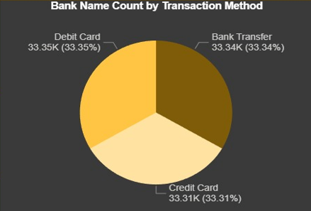
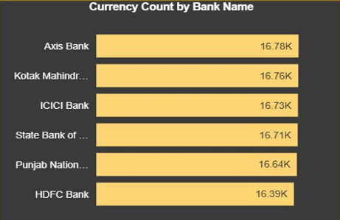
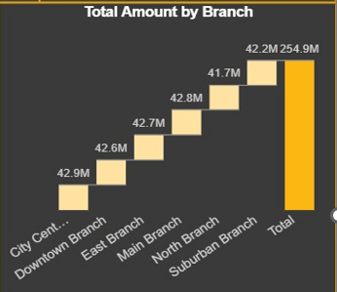
INSIGHTS AND SUGGESTIONS.
🎯 Insights:
All three transaction methods are almost equally used.
👉 Customers are diversified in payment preferences.
💡 Suggestions:
Maintain equal support & security across all channels.
Run promotional offers on slightly lower-used method to balance usage.
Monitor fraud risk across all equally.
🎯 Insights:
All banks have very close transaction counts.
No bank is extremely dominating.
👉 Customer distribution is evenly spread.
💡 Suggestions:
Focus on customer retention since competition is close.
Introduce loyalty programs for high-frequency banks.
Study small differences to identify growth opportunities.
🎯 Insights:
Each branch contributes almost similar amounts (around 42M).
👉 Branch performance is well balanced.
💡 Suggestions:
Analyse cost vs revenue per branch.
Identify which branch has higher profitability (not just total amount).
Expand model of best-performing branch.

Slide 10
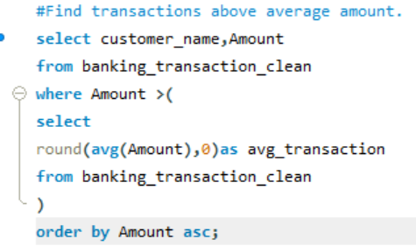
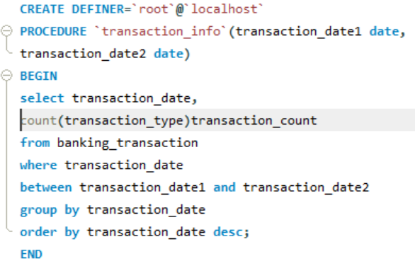
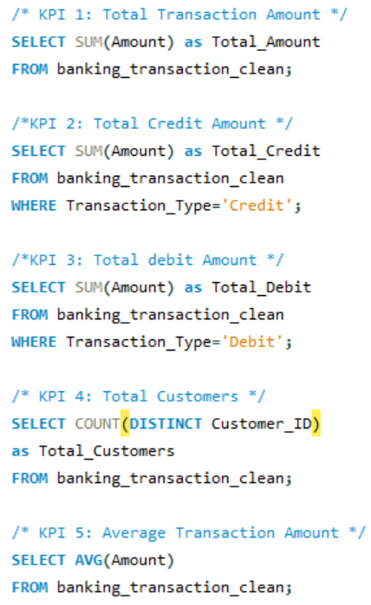
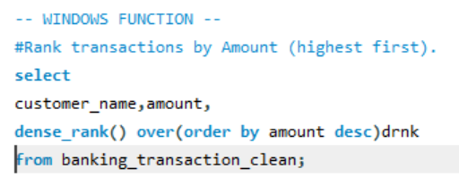
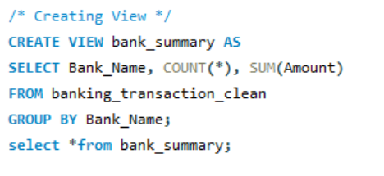
SQL QUERIES
SUB QUERY, WINDOW’S FUNCTION, VIEW AND STORED PROCEDURE.
SUB QUERY
WINDOW’S FUNCTION
STORED PROCEDURE KPI’S
VIEW

Slide 11
SUMMARY
This project successfully demonstrates the development of a comprehensive banking analysis system consisting of two major modules: Bank Loan Management and Credit & Debit Card System.
The Bank Loan module focuses on managing the complete loan lifecycle — from application processing and eligibility verification to approval, interest calculation, and repayment tracking. The Credit & Debit module ensures smooth card issuance, transaction monitoring, secure payments, and balance management.
Through the analysis of key performance indicators (KPIs), we observed strong financial performance. The total loan disbursed and repayment collection indicate healthy profitability, supported further by interest income and fee generation. The credit and debit transaction data reflects balanced customer usage patterns and stable transaction volumes across banks and branches.
Using tools such as Excel, SQL, Tableau, and Power BI, we transformed raw banking data into meaningful insights. SQL was used for efficient data management, including subqueries, window functions, views, and stored procedures, while visualization tools helped identify trends, seasonal patterns, regional performance, and customer behavior.
Overall, the dashboards provide a clear, data-driven view of financial performance, operational efficiency, and customer distribution.

Slide 12
CONCLUSION
In conclusion, this project highlights how data analytics can significantly enhance decision-making in the banking sector. By analyzing loan performance, transaction trends, regional distribution, and customer segments, the bank can make smarter, more strategic business decisions.
The findings suggest opportunities for:
Expanding into low-performing regions
Balancing customer segment concentration
Strengthening digital lending strategies
Improving customer retention programs
Enhancing risk management during economic fluctuations
The integration of data management (SQL) and visualization tools (Excel, Tableau, Power BI) ensures accuracy, transparency, and actionable insights.
This project clearly demonstrates that when banking operations are supported by data-driven analysis, institutions can improve profitability, maintain operational balance, enhance customer satisfaction, and ensure long-term financial stability.

Slide 13


